Slide 1
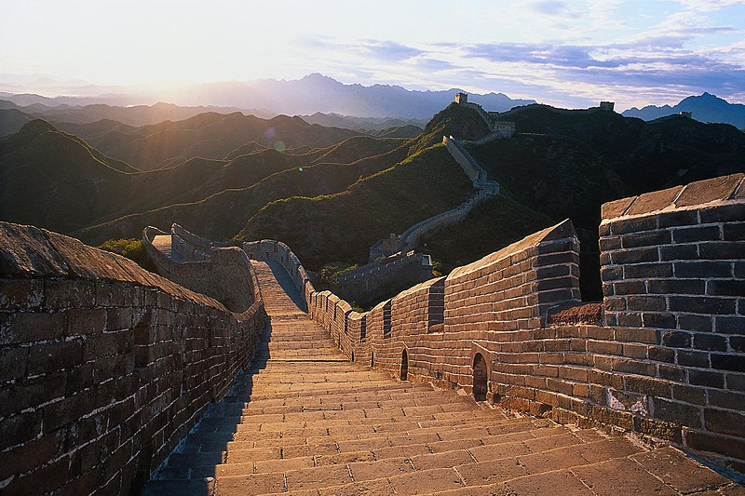
China Tour Guide Website Design
Fall 2021, WD, John-Abbott College

Slide 2
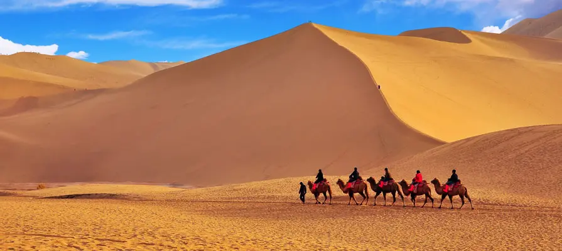


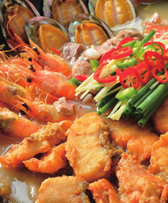
Contents
Team members
Defining the Purpose and Target Audience
Planning
Implementation
Project Milestones
Summary and References

Slide 3


Team Members
Guo, Shengguang
Lin, Hong
Shen, Fan
Su, Xiaoming
Zhao, Guixia

Slide 4
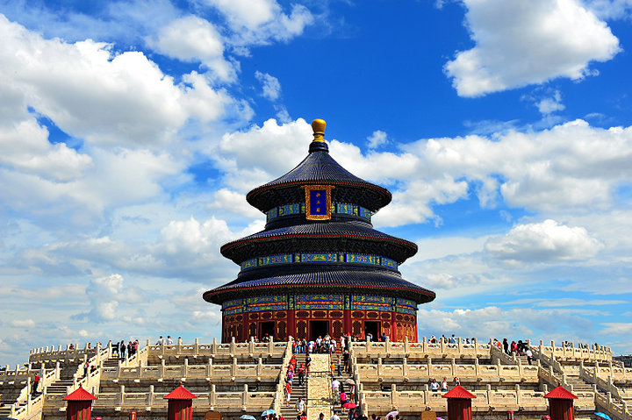
Defining the Purpose and Target Audience
Aug.27

Slide 5
Defining the Purpose and Target Audience
Purpose:
Our project is to design, develop, publish, and maintain a web site of introduction of China tourist attractions by using learned design practices.
we worked in team from beginning to the end for preparing final project. We use all related techniques covered in this course such as HTML and CSS languages.
We use the IDE MS visual studio.
We select 4 cities of China, Xiamen, Jinan, Dunhuang and Xi’an.

Slide 6
Defining the Purpose and Target Audience
Target Audience:
People who are interesting on travelling to China.
Travel agencies who want to develop China tour business.
Some tourism website in China.

Slide 7
Planning
Aug.27 ~ Aug.28

Slide 8
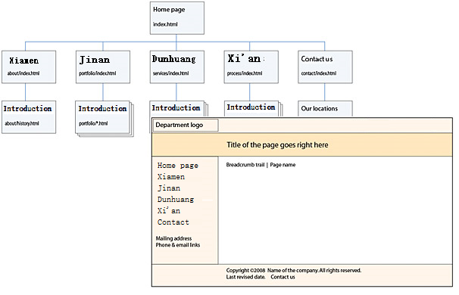
Planning
Define the structure and page layout.
Determine the website contents.
Select from different plans.

Slide 9
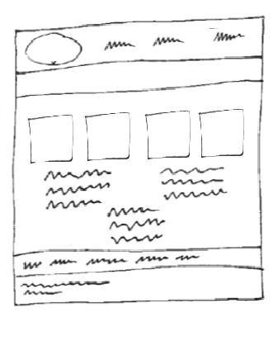
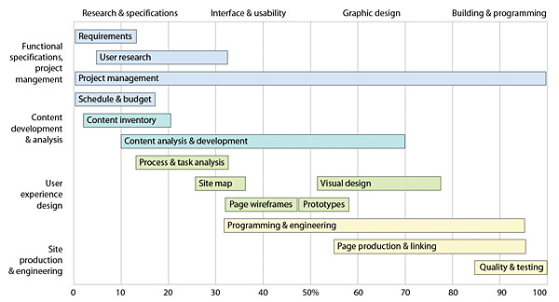
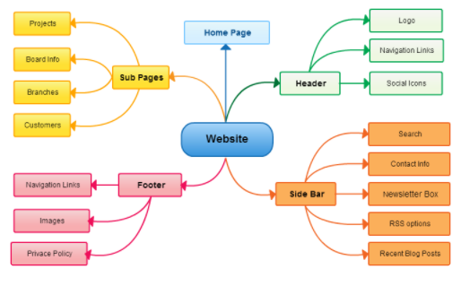
Planning
Begin with a plan, create a visual mind map, create sample page sketches, and a timeline, assemble the site.

Slide 10
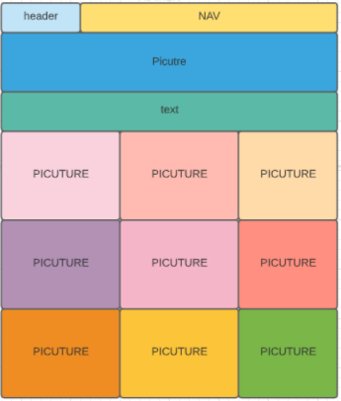
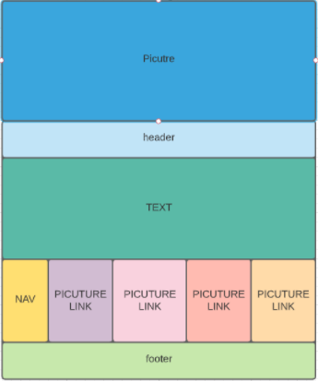
Draft structures for sub webpages
Xiamen
Dunhuang

Slide 11
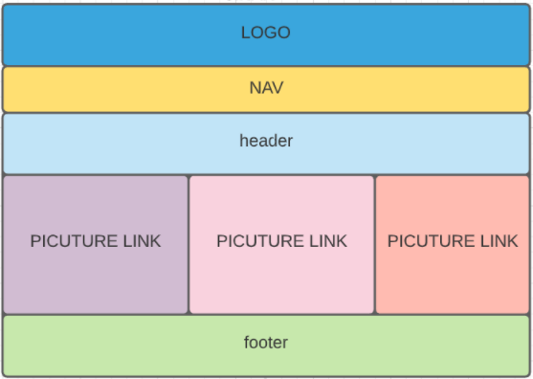
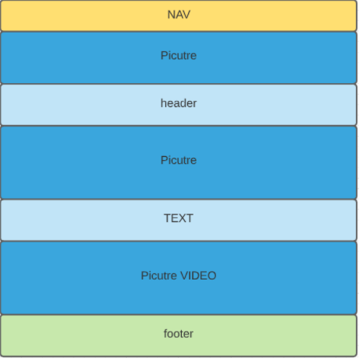
Draft structures for sub webpages
Jinan page
Xi’an Page

Slide 12
Implementation
Aug.29 ~ Aug.31

Slide 13
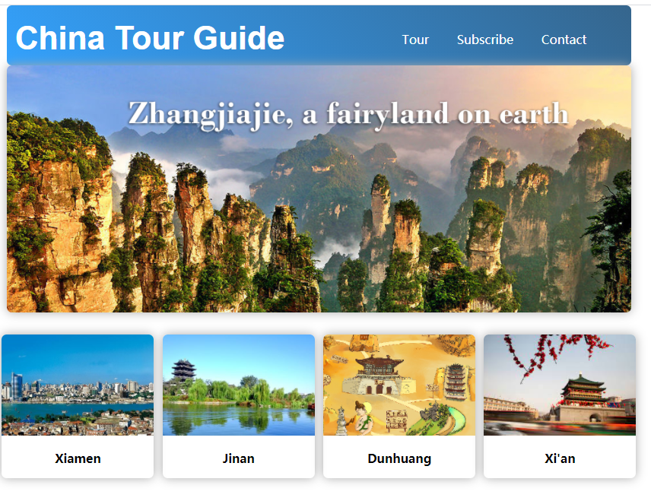
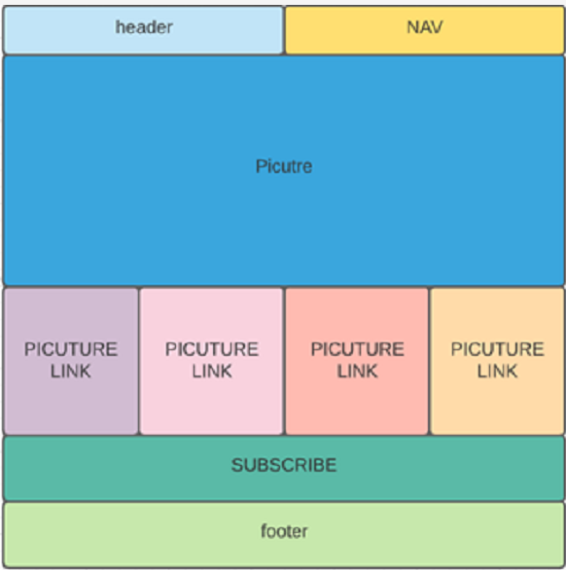
Implementation
Create the web pages using MS Visual Studio
Structure of homepage.

Slide 14
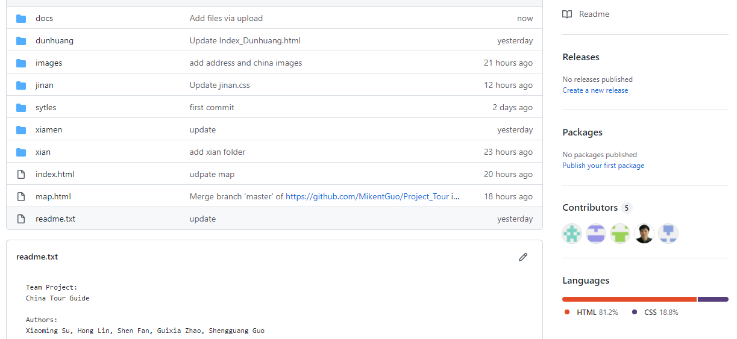
Implementation
Team work on Github

Slide 15
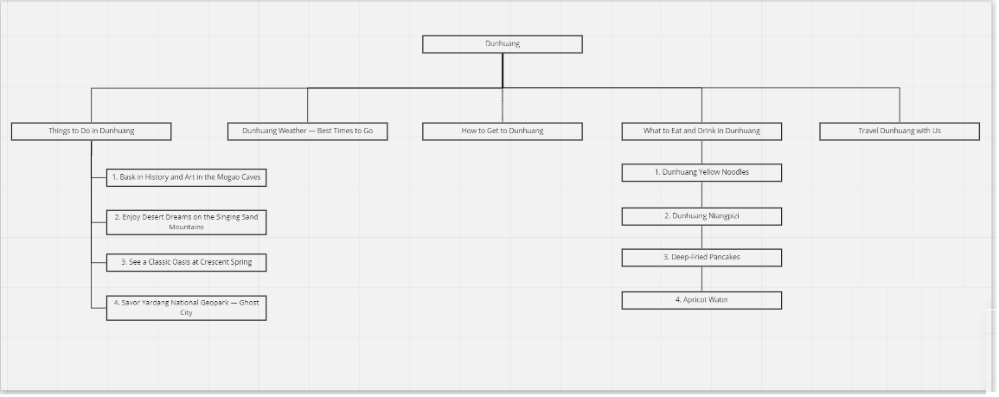
Website Structure Chart

Slide 16
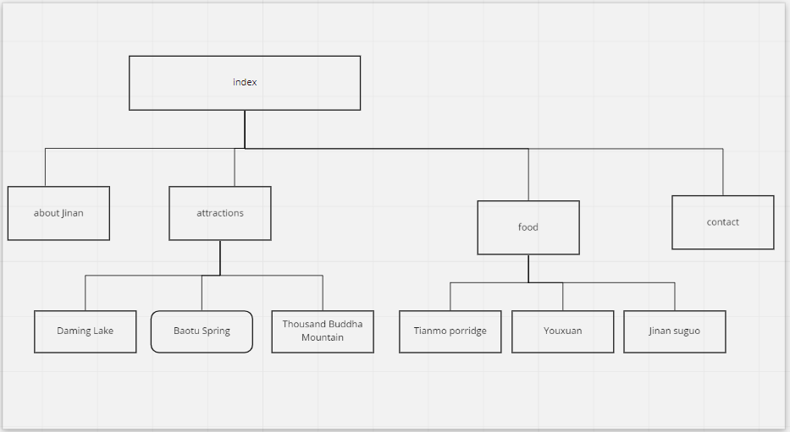
Website Structure Chart

Slide 17
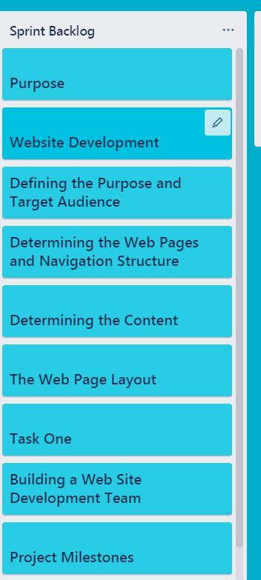
Spring Method by Trello
Team reviews every web page and check if they are running well.
Make changes or corrections. Do final change and adjustment.
Project WD on trello.com

Slide 18
Schedule and Milestone
Aug. 27
Day 1:
Launch: kick off meeting, define project purpose and target audience.
Aug. 28
Day 2:
Planning: Meeting together to discuss web design mothed, tools, layout and contents
Aug. 29
Aug. 30
Day 3:
Implementation: missions' assignment and team members start to create web
Day 5:
Review each web page and make final changes and corrections. Final testing
Aug. 31
Milestone
Day 4:
Team work together for integrating, do consolidation and adjustment

Slide 19
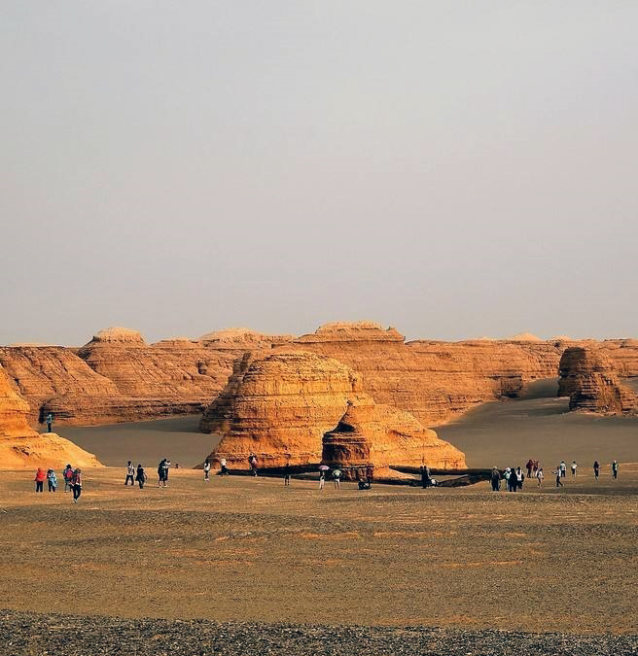

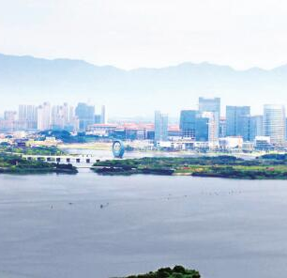
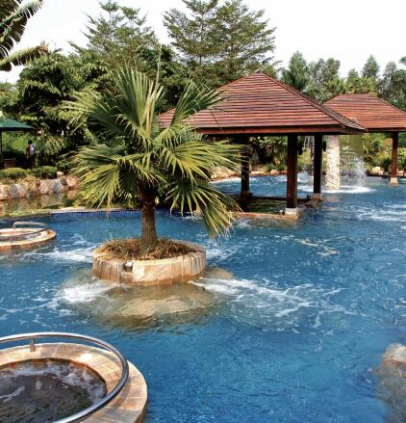
Summary and Reference·
Summary:
Structure planning.
HTML code programming.
CSS design.
Contents writing.
Integrating.

Slide 20

Summary and Reference
1. jnwl.jinan.gov.cn
2. www.xiameng.com
3. http://www.visitxm.com
4. www.dunhuangtour.com
5. www.w3schools.com

Slide 21
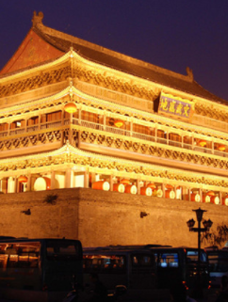
Thank you Merci 谢谢

